Slide 1
Units of Measurement

Slide 2
Using SI Units
The standards of measurement used in science are those of the metric system.
All metric units are based on multiples of 10. As a result, you can convert between units easily.

Slide 3
Using SI Units
The metric system was originally established in France in 1795.
The International System of Units (abbreviated SI after the French name, Le Système International d’Unités) is a revised version of the metric system.
The SI was adopted by international agreement in 1960.

Slide 4
Using SI Units
There are seven SI base units.
From these base units, all other SI units of measurement can be derived.
Derived units are used for measurements such as volume, density, and pressure.
SI Base Units
Quantity | SI base unit | Symbol
Length | meter | m
Mass | kilogram | kg
Temperature | kelvin | K
Time | second | s
Amount of substance | mole | mol
Luminous intensity | candela | cd
Electric current | ampere | A

Slide 5
Using SI Units
Units of Length
The table below lists the prefixes in common use.
Commonly Used Metric Prefixes
Prefix | Symbol | Meaning | Factor
mega | M | 1 million times larger than the unit it precedes | 10⁶
kilo | k | 1000 times larger than the unit it precedes | 10³
deci | d | 10 times smaller than the unit it precedes | 10⁻¹
centi | c | 100 times smaller than the unit it precedes | 10⁻²
milli | m | 1000 times smaller than the unit it precedes | 10⁻³
micro | μ | 1 million times smaller than the unit it precedes | 10⁻⁶
nano | n | 1 billion times smaller than the unit it precedes | 10⁻⁹
pico | p | 1 trillion times smaller than the unit it precedes | 10⁻¹²

Slide 6
Using SI Units
Units of Volume
The space occupied by any sample of matter is called its volume.
You calculate the volume of any cubic or rectangular solid by multiplying its length by its width by its height.
The unit for volume is thus derived from the units of length.

Slide 7
Using SI Units
Units of Volume
The SI unit of volume is the amount of space occupied by a cube that is 1 m along each edge.
This volume is a cubic meter (m³).
A more convenient unit of volume for everyday use is the liter, a non-SI unit.
A liter (L) is the volume of a cube that is 10 centimeters (10 cm) along each edge (10 cm x 10 cm x 10 cm = 1000 cm³ = 1 L).

Slide 8
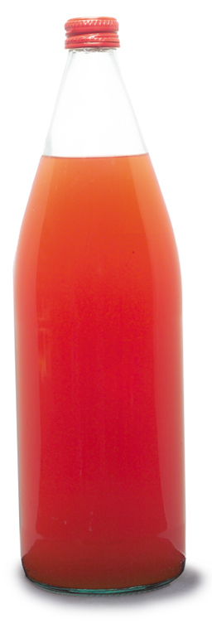
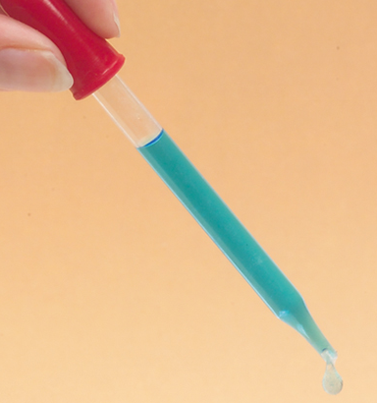
Using SI Units
Units of Volume
These figures give you some idea of the relative sizes of a liter and a milliliter.
1 L
1 mL

Slide 9
Using SI Units
Units of Volume
There are many devices for measuring liquid volumes, including graduated cylinders, pipets, burets, volumetric flasks, and syringes.
The volume of substances will change with temperature, so accurate volume-measuring devices are calibrated at a given temperature—usually 20 degrees Celsius (20°C), which is about normal room temperature.

Slide 10
Using SI Units
Units of Volume
The relationships among common metric units of volume are shown in the table below.
Metric Units of Volume
Unit | Symbol | Relationship | Example
Liter | L | base unit | quart of milk ≈ 1 L
Milliliter | mL | 10³ mL = 1 L | 20 drops of water ≈ 1 mL
Cubic centimeter | cm³ | 1 cm³ = 1 mL | cube of sugar ≈ 1 cm³
Microliter | μL | 10³ μL = 1 L | crystal of table salt ≈ 1 μL

Slide 11
Using SI Units
Units of Mass
The mass of an object is measured in comparison to a standard mass of 1 kilogram (kg), which is the basic SI unit of mass.
A gram (g) is 1/1000 of a kilogram

Slide 12
Using SI Units
Units of Mass
The relationships among units of mass are shown in the table below.
Metric Units of Mass
Unit | Symbol | Relationship | Example
Kilogram (base unit) | kg | 1 kg = 10³ g | small textbook ≈ 1 kg
Gram | g | 1 g = 10⁻³ kg | dollar bill ≈ 1 g
Milligram | mg | 10³ mg = 1 g | ten grains of salt ≈ 1 mg
Microgram | μg | 10⁶ μg = 1 g | particle of baking powder ≈ 1 μg

Slide 13
Using SI Units
Units of Mass
Weight is a force that measures the pull on a given mass by gravity.
Weight, a measure of force, is different from mass, which is a measure of the quantity of matter.
The weight of an object can change with its location.
An astronaut in orbit is weightless, but not massless.

Slide 14
Using SI Units
Units of Energy
The capacity to do work or to produce heat is called energy.
The SI unit of energy is the joule (J), named after the English physicist James Prescott Joule (1818–1889).
A common non-SI unit of energy is the calorie.
One calorie (cal) is the quantity of heat that raises the temperature of 1 g of pure water by 1°C.

Slide 15
Using SI Units
Units of Energy
Conversions between joules and calories can be carried out using the following relationships.
1 J = 0.2390 cal
1 cal = 4.184 J
A kilojoule is 1000 joules; a kilocalorie is 1000 calories.

Slide 16
Temperature Scales
Temperature is a measure of how hot or cold an object is.
An object’s temperature determines the direction of heat transfer.
When two objects at different temperatures are in contact, heat moves from the object at the higher temperature to the object at the lower temperature.

Slide 17
Temperature Scales
Almost all substances expand with an increase in temperature and contract as the temperature decreases.
A very important exception is water.
These properties are the basis for the common bulb thermometer.

Slide 18
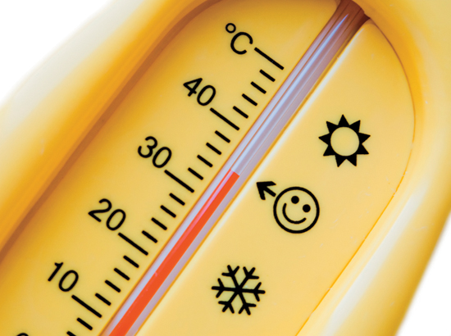
Temperature Scales
The liquid in a thermometer expands and contracts more than the volume of the glass, producing changes in the column height of liquid.

Slide 19
Temperature Scales
Scientists commonly use two equivalent units of temperature, the degree Celsius and the kelvin.

Slide 20
Temperature Scales
The Celsius scale sets the freezing point of water at 0°C and the boiling point of water at 100°C.
The distance between these two fixed points is divided into 100 equal intervals, or degrees Celsius (°C).

Slide 21
Temperature Scales
Another temperature scale used in the physical sciences is the Kelvin, or absolute, scale.
This scale is named for Lord Kelvin (1824–1907), a Scottish physicist.
On the Kelvin scale, the freezing point of water is 273.15 kelvins (K), and the boiling point is 373.15 (K).
Note that with the Kelvin scale, the degree sign is not used.

Slide 22
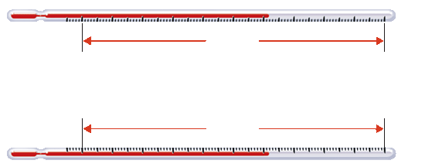
Temperature Scales
The figure below compares the Celsius and Kelvin scales.
The zero point on the Kelvin scale, 0 K, or absolute zero, is equal to –273.15°C.
Celsius
100
divisions
0°C
Freezing point
of water
273.15 K
100°C
Boiling point
of water
373.15 K
100
divisions
Kelvin

Slide 23
Temperature Scales
Because one degree on the Celsius scale is equivalent to one kelvin on the Kelvin scale, converting from one temperature to another is easy.
You simply add or subtract 273, as shown in the following equations.
K = °C + 273
°C = K – 273

Slide 24
Sample Problem 3.7
Converting Between Temperature Scales
Normal human body temperature is 37°C. What is this temperature in kelvins?

Slide 25
Sample Problem 3.7
Analyze List the known and the unknown.
Use the known value and the equation K = °C + 273 to calculate the temperature in kelvins.
KNOWN Temperature in °C = 37°C
UNKNOWN Temperature in K = ? K
1

Slide 26
Sample Problem 3.7
Calculate Solve for the unknown.
Substitute the known value for the Celsius temperature into the equation and solve.
K = °C + 273 = 37 + 273 = 310 K
2

Slide 27
Sample Problem 3.7
Evaluate Does the result make sense?
You should expect a temperature in this range, since the freezing point of water is 273 K and the boiling point of water is 373 K; normal body temperature is between these two values.
3

Slide 28
Density
Density
What determines the density of a substance?

Slide 29
Density
The relationship between an object’s mass and its volume tells you whether it will float or sink.
This relationship is called density.
Density is the ratio of the mass of an object to its volume.
mass
Density =
volume

Slide 30
Density
When mass is measured in grams, and volume in cubic centimeters, density has units of grams per cubic centimeter (g/cm³).
The SI unit of density is kilograms per cubic meter (kg/m³).

Slide 31
Density
This figure compares the density of four substances: lithium, water, aluminum, and lead.
10 g
Increasing density (mass per unit volume)
10 g
10 g
10 mL
5 mL
1 mL
Increasing temp.
D=10g/10mL = 1g/mL
D=10g/1mL = 10g/mL
D=10g/5mL = 2g/mL

Slide 32
Density
Density is an intensive property that depends only on the composition of a substance, not the size of the sample.
Intensive = type of matter
Extensive = amount of matter

Slide 33
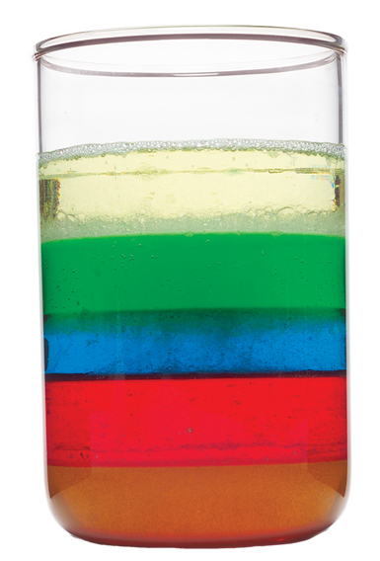
Density
Because of differences in density, liquids separate into layers.
As shown at right, corn oil floats on top of water because it is less dense.
Corn syrup sinks below water because it is more dense.
Corn oil
Water
Corn syrup

Slide 34
Interpret Data
Densities of Some Common Materials
Solids and Liquids |  | Gases
Material | Density at 20°C (g/cm³) | Material | Density at 20°C (g/L)
Gold | 19.3 | Chlorine | 2.95
Mercury | 13.6 | Carbon dioxide | 1.83
Lead | 11.3 | Argon | 1.66
Aluminum | 2.70 | Oxygen | 1.33
Table sugar | 1.59 | Air | 1.20
Corn syrup | 1.35–1.38 | Nitrogen | 1.17
Water (4°C) | 1.000 | Neon | 0.84
Corn oil | 0.922 | Ammonia | 0.718
Ice (0°C) | 0.917 | Methane | 0.665
Ethanol | 0.789 | Helium | 0.166
Gasoline | 0.66–0.69 | Hydrogen | 0.084

Slide 35
Density
What happens to the density of a substance as its temperature increases?
The volume of most substances increases as the temperature increases, while the mass remains the same.
Since density is the ratio of an object’s mass to its volume, the density of a substance generally decreases as its temperature increases.
Water is an important exception.

Slide 36
Sample Problem 3.8
Mass =
Volume =
Start with the equation for density.
mass
Density =
volume
V x D
mass
Density

